Slide 1
quicksort

Slide 2











Slide 3
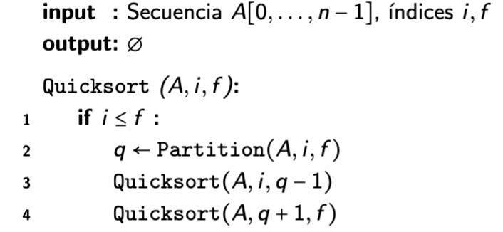
Partition(A,0,10)
7
3
5
2
1
9
7
8
6
4
3
Pivote=6
0
1
2
3
4
5
6
7
8
9
10
Partition(A,0,5)
3
5
2
1
3
4
6
8
7
9
7
A, Pivote 2
Partition(A,0,0)
1
2
4
3
3
5
6
8
7
9
7
A, Pivote 1
Partition(A,2,5)
1
2
4
3
3
5
6
8
7
9
7
A, Pivote 4
Partition(A,2,3)
1
2
3
3
4
5
6
8
7
9
7
A, Pivote 3
Partition(A,3,3)
1
2
3
3
4
5
6
8
7
9
7
A, Pivote 3
Partition(A,5,5)
1
2
3
3
4
5
6
8
7
9
7
A, Pivote 5
Partition(A,7,10)
1
2
3
3
4
5
6
8
7
9
7
A, Pivote 7
Partition(A,8,10)
1
2
3
3
4
5
6
7
7
9
8
A, Pivote 7
Partition(A,9,10)
1
2
3
3
4
5
6
7
7
9
8
A, Pivote 9
Partition(A,9,9)
1
2
3
3
4
5
6
7
7
8
9
A, Pivote 8
1
2
3
3
4
5
6
7
7
8
9

